Slide 1
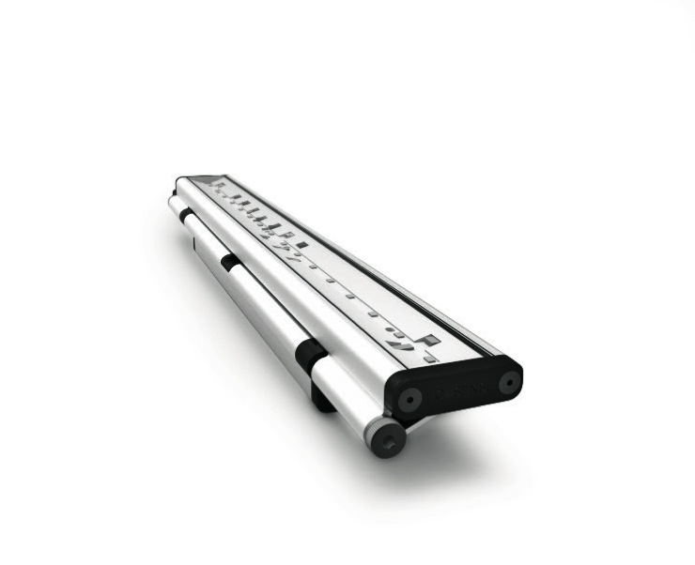
Sales Presentation
Fall, 2015

Slide 2
TRŌV | Freedom to Create
TRŌV is an intelligently designed platform giving designers a seemingly limitless supply of options with the largest selection of lumen outputs, CCTs, and beam angles on the market.
Without limits, TRŌV gives designers the Freedom to Create.

Slide 3
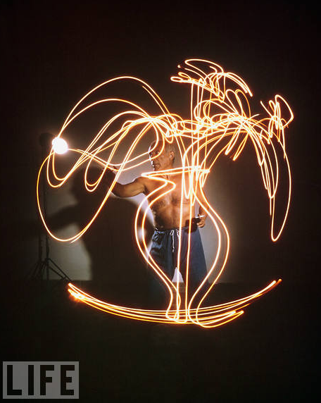
TRŌV | Freedom to Create
TRŌV is the Freedom to Create
Create scenes
Create colors
Create textures
Create quality
Create anywhere
Photo by Gjon Mili via Life Magazine. Pablo Picasso 1949.
Notes:
with zero percent dimming and five lumen outputs.
with seven whites and four mono-colors.
with twenty-four beam angles.
with eighty and ninety CRI options.
with interior and exterior options and multi volt for around the world installations

Slide 4
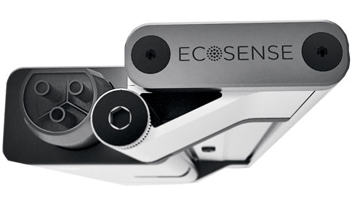
Product Advancements | Design
Exclusive Product Design
  20,000+ product variations
  Ultra slim and versatile industrial design
  Exclusive “Flip to Flat” hinge
  Patented IP66 connector design

Slide 5
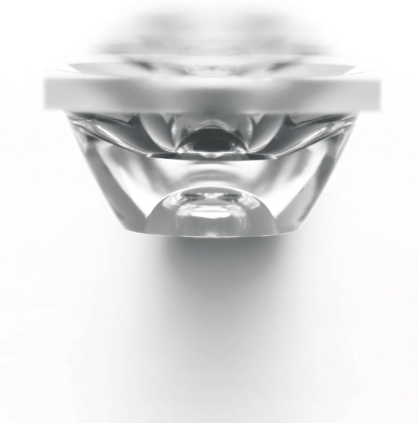
Product Advancements | Optics
Precise Optical Design
  Patented system of precisely designed optical lens
  Meticulously designed optics for clean & precise beam angles
  24 total beam angle options

Slide 6
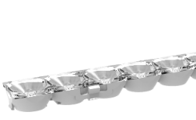
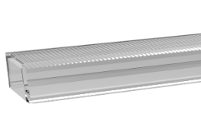
Product Advancements | Optics
+
=
Full Range 24 Options:
Secondary Optical Module
  9 x 9
  15 x 15
  25 x 25
  40 x 40
  120 Degree
  Line of Light
  Asymmetric
Tertiary Optical Module
  Clear
  0 x 8
  0 x 20
  0 x 50
  30 x 0
  Line of Light
  Asymmetric
9x9* | 15x65 | 40x48
9x17* | 45x15 | 40x60
9x29 | 25x25 | 40x90
9x59 | 25x33 | 70x40
39x9 | 25x45 | 70x70
15x15 | 25x75 | 120
15x23 | 55x25 | LOL
15x35 | 40x40 | ASYM
*9x9 and 9x17 are not currently available

Slide 7
Product Advancements | Dimming
Patented Dimming Technology
  Patented “Dim to 0%“ technology delivers smooth, flicker-free dimming
  ELV dimming down to 0%
  Multi-Volt digital power supply automatically detects voltage between 120V-277V
  Compatible with LDCM & LDCM-Plenum Rated 0-10V dimming modules

Slide 8
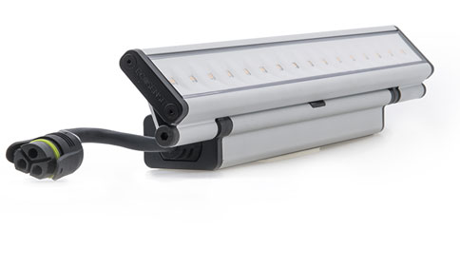
Product Advancements | Quality Light
Highest Quality of Light
  High quality LEDs
  Single Binning
  80+ and 90+ CRI
  CCT range of 2200K to 5000K
  Mono colors Red, Green, Blue, and Amber

Slide 9
Product Details

Slide 10
TRŌV | Applications
Trov adapts to any environment giving Designers more freedom and greater control over their projects
Cove | Architectural ledge or recess on the upper part of a wall. Trov | L35 Interior (120° Beam) Trov | L50 Exterior (120° Beam) Trov | L50 Asymmetric Trov | L50 Line of Light
Graze | Light that is close to and parallel to a surface and creates strong contrast. Trov | L50 Asymmetric Trov | L50 Interior/Exterior 9° Vertical Beam: 9 x 9*, 9 x 17*, 9 x 29, 9 x 59 15° Vertical Beam: 15 x 15, 15 x 23, 15 x 35, 15 x 65
Wash | Light striking a surface from a distance that reduces or eliminates contrast. Trov | L50 Asymmetric Trov | L50 Interior/Exterior 25° Vertical Beam: 25 x 25, 25 x 33, 25 x 45, 25 x 75 40° Vertical Beam: 40 x 40, 40 x 48, 40 x 60, 40 x 90 Elliptical Beam Angles: 39 x 9, 45 x 15, 55 x 25, 70 x 40
Asymmetric | Light that uniformly illuminates a ceiling or wall without dark shadows in the cove Trov | L50 Asymmetric
*9x9 and 9x17 are not currently available

Slide 11
TRŌV | Optic Selection Guide
Ecospec Beam Angle |  | TROV Beam Angle
6x6 |  | 9x9*
6x15 |  | 9x17*
10x60 |  | 9x59
17x35 |  | 9x29
30x60 |  | 40x60
60x60 |  | 70x70
*9x9 and 9x17 are not currently available

Slide 12
TRŌV | Lumen Selection Guide
Ecospec Model Number | Watts/ft | Lumens/ft (2700K-4000K) |  |  | Efficacy (2700K-4000K) |  |  | Trov Model Number | Watts/ft | Lumens/ft (2700K - 4000K) |  |  | Efficacy (2700K - 4000K)
LCIL | 3 | 150 | - | 182 | 57 | - | 68 | L35 | 2 | 143 | - | 163 | 71 | - | 82
LCIS | 5 | 223 | - | 306 | 52 | - | 70 | L35 | 4 | 359 | - | 393 | 90 | - | 98
HPIL | 8 | 500 | - | 569 | 71 | - | 86 | L35 | 6 | 524 | - | 569 | 87 | - | 95
HPIS | 10 | 639 | - | 744 | 71 | - | 82 | L35 | 8 | 664 | - | 714 | 83 | - | 89
HPEL | 8 | 508 | - | 561 | 71 | - | 78 | L50 | 8 | 569 | - | 676 | 71 | - | 85
HPES | 12 | 709 | - | 823 | 65 | - | 75 | L50 | 10 | 721 | - | 856 | 72 | - | 86
WWIL (6x6) | 8 | 508 | - | 561 | 76 | - | 87 | L50 (9x9) | 8 | 569 | - | 676 | 71 | - | 85
WWIS (6x6) | 12 | 772 | - | 909 | 66 | - | 79 | L50 (9x9) | 10 | 721 | - | 856 | 72 | - | 86
WWEA (6x6) | 5 | 414 | - | 459 | 77 |  | 91 | L50 (9x9) | 4 | 270 | - | 320 | 67 | - | 80
WWEL (6x6) | 8 | 576 | - | 631 | 80 | - | 89 | L50 (9x9) | 8 | 569 | - | 676 | 71 | - | 85
WWES (6x6) | 12 | 826 | - | 901 | 77 | - | 82 | L50 (9x9) | 10 | 721 | - | 856 | 72 | - | 86

Slide 13
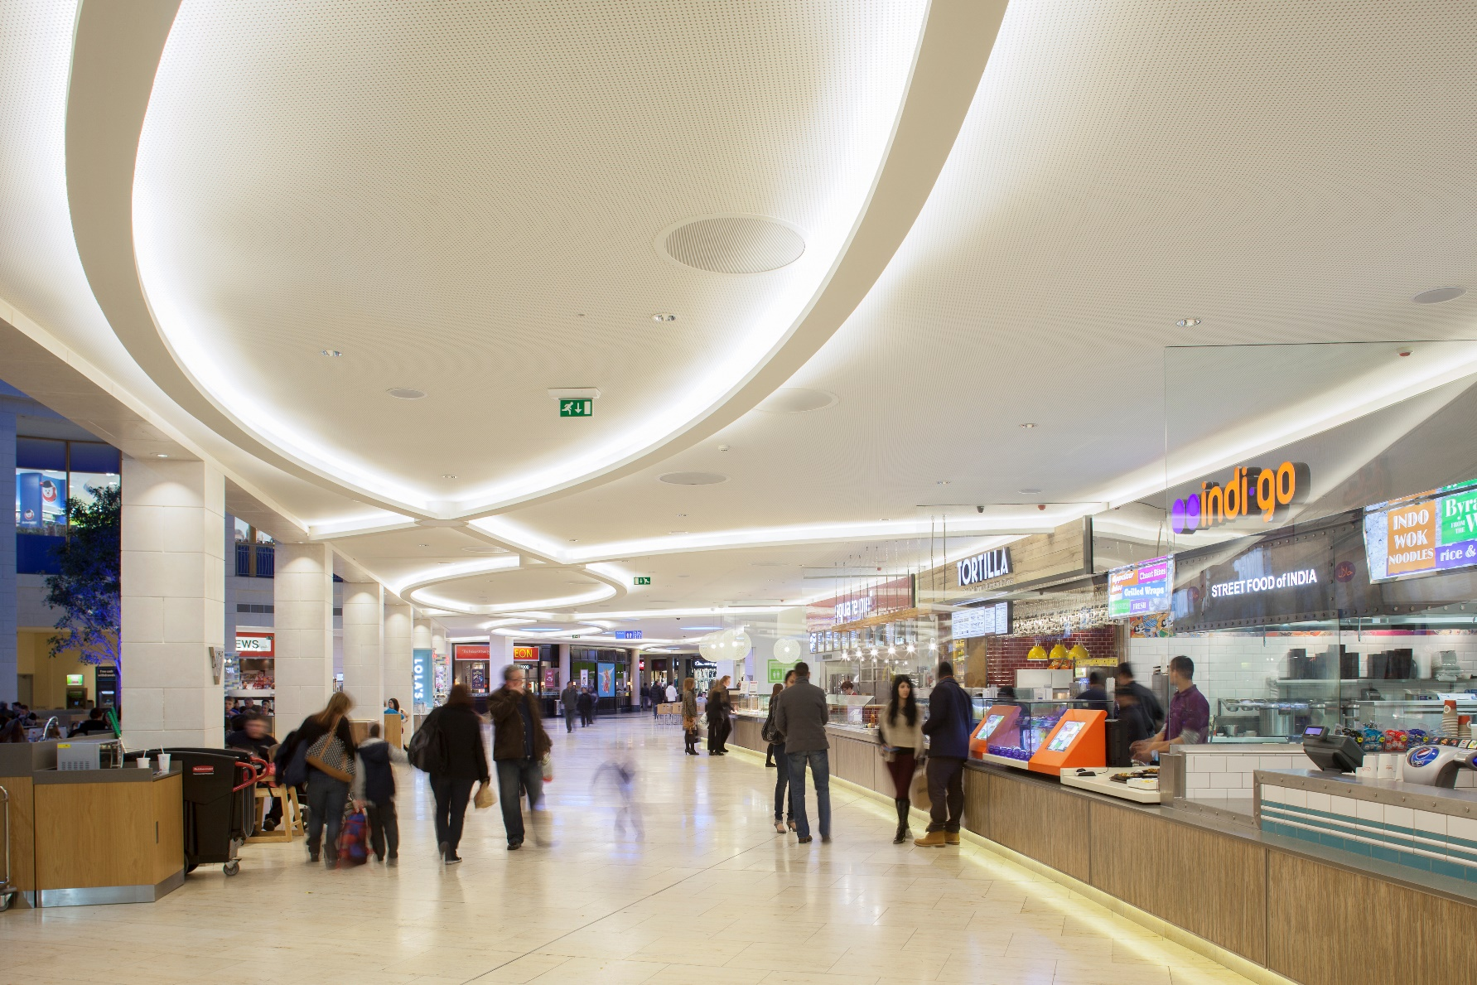
TRŌV | Applications - Cove

Slide 14
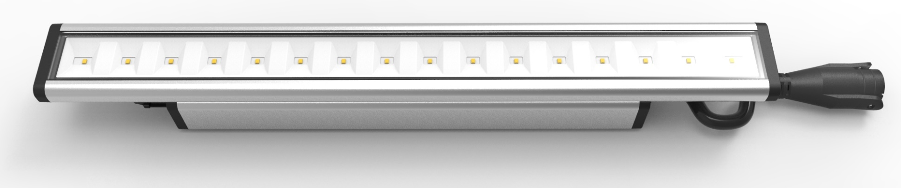
Cove | L35 Interior (120°)
Trov | L35 Interior is an Ultra-Slim Profile Linear Luminaire ideal for coves and other hidden accent applications
  Patented ELV Dim to 0% output
  Power Options: 2W, 4W, 6W, 8W, and 10W per foot
  Wide CCT Range: 2200K, 2500K, 2700K, 3000K, 3500K, 4000K, and 5000K
  Mono Colors available in Red, Green, Blue, and Amber
  90 CRI available in 2700K-4000K only
  Multi-Volt: 120V-277V input voltage
  Aiming Adjustment: 0º to 180º with Flip to Flat™ Design
  Interior Applications only
Smallest 900Lm/Ft Cove

Slide 15
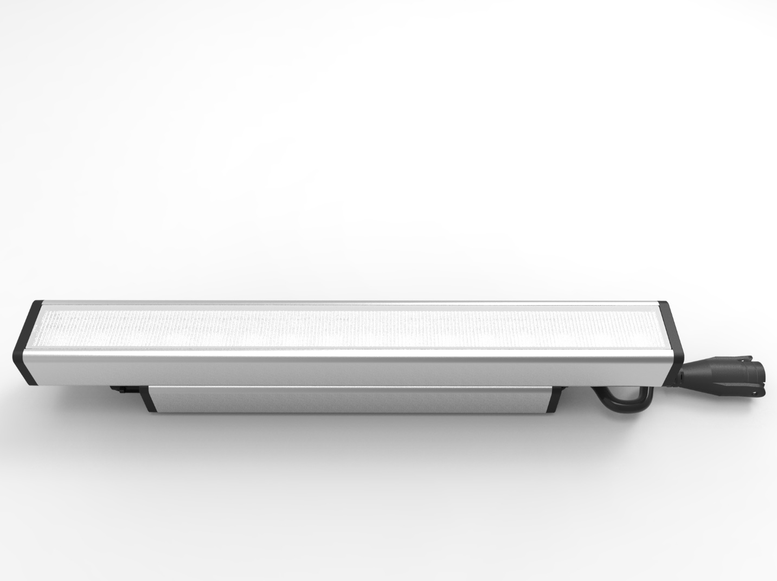
Cove | L50 Exterior Cove (120°)
Trov | L50 exterior cove is a low profile high powered cove ideal for lighting coves and accenting architectural details in exterior applications.
  Patented ELV dim to 0% output
  Power Options: 2W, 4W, 6W, 8W, and 10W per foot
  Wide CCT range 2200K, 2700K, 3000K, 3500K, 4000K, and 5000K
  90 CRI available in 2700K-4000K
  Mono colors in Red, Green, Blue, and Amber are also available
  Multi-Volt 120V-277V input voltage
  Aiming adjustment from 0°to 180°with patent pending flip-to-flat design
  Exterior IP66 utilizing GORE® Vent technology.
Smallest Exterior Cove

Slide 16
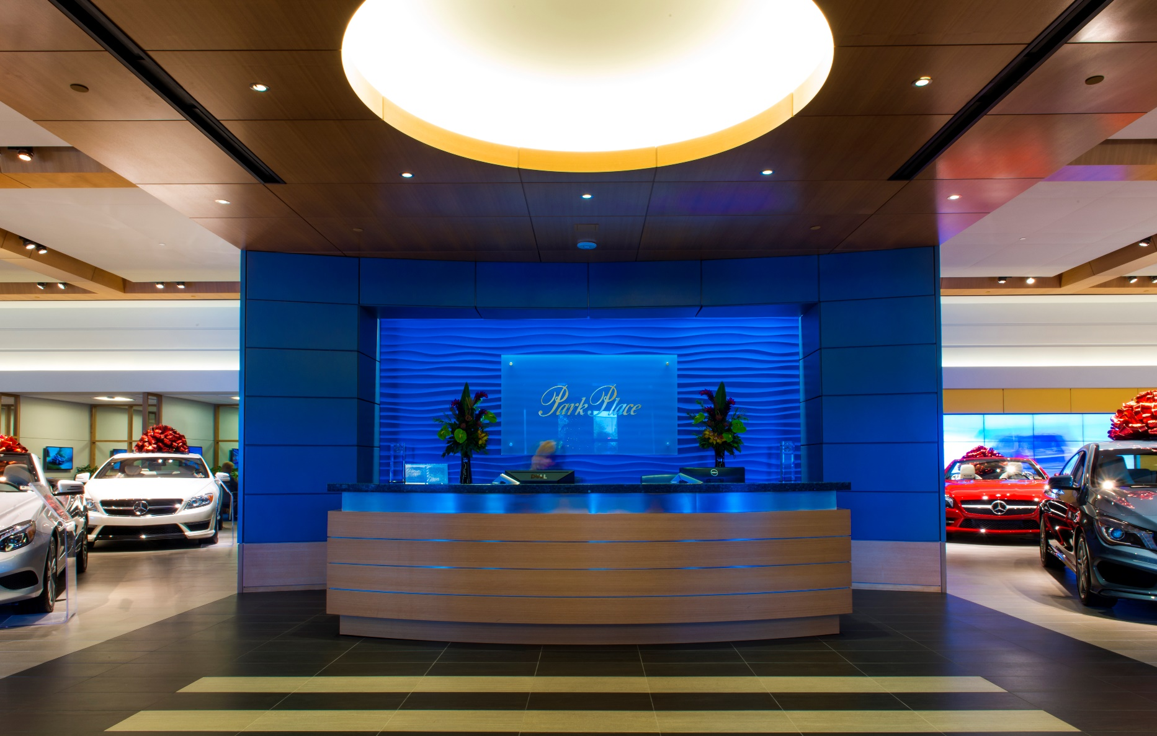
TRŌV | Applications – Asymmetric Cove

Slide 17
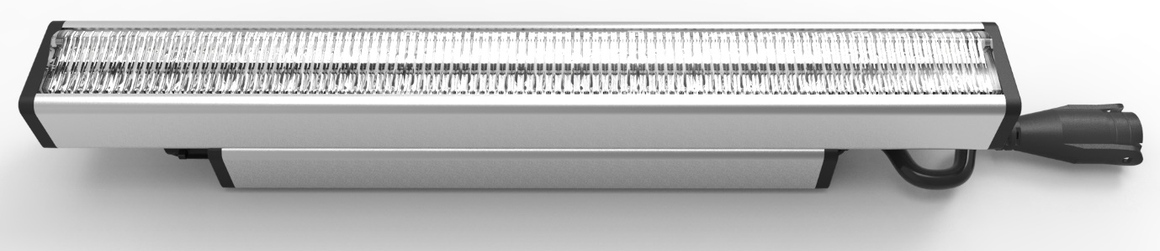
Cove | L50 Interior & Exterior Asymmetric
Trov | L50 Asymmetric is the most compact asymmetric product on the market.
ideal for coves where ceiling uniformity is critical. The asymmetric throw will spread light evenly across the ceiling while still keeping the back of the cove illuminated.
  Only 54mm(2-1/8”) tall by 42mm(1-5/8”) wide
  Patented ELV dim to 0% output
  Power Options: 2W, 4W, 6W, 8W, and 10W per foot
  Efficacy up to 100Lm/W
  Wide CCT range 2200K, 2700K, 3000K, 3500K, 4000K, and 5000K
  90 CRI available in 2700K-4000K
  Mono colors in Red, Green, Blue, and Amber are also available
  Multi-Volt 120V-277V input voltage
  Aiming adjustment from 0°to 180°with patent pending flip-to-flat design
  GORE® Vent technology
Smallest Asymmetric Cove

Slide 18
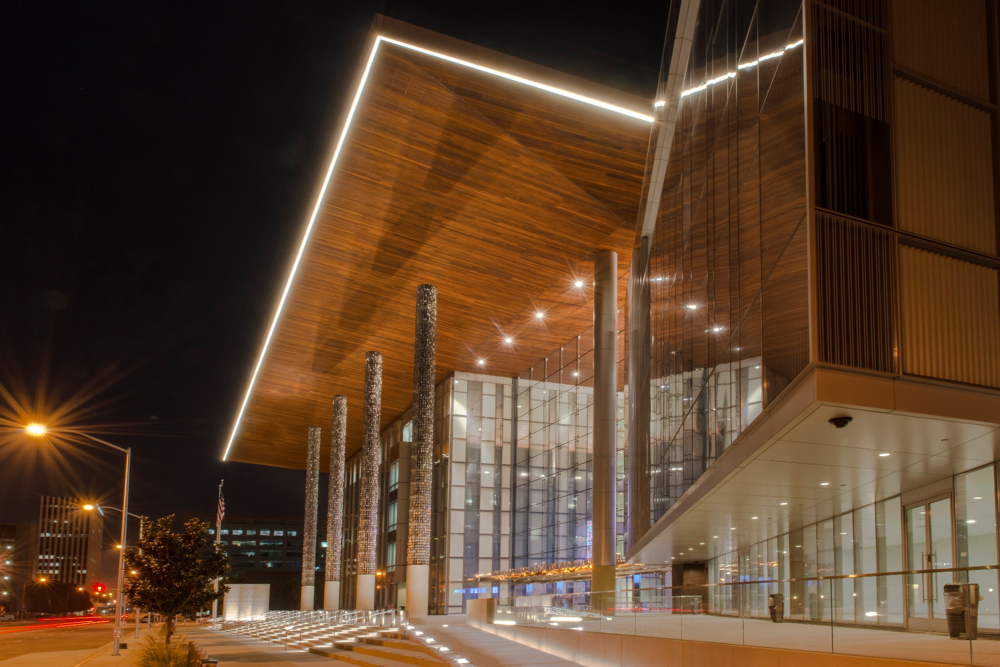
TRŌV | Applications – Line of Light

Slide 19
Cove | L50 Interior & Exterior Line of Light
Trov | L50 Line of Light is first line voltage LED linear delivering uninterrupted line of light with no visible pixilation from LEDs. Ideal for any application where the fixture will be viewed by people in the space. It can be used as an accent, illuminating highly reflective surfaces, or as an under cabinet where the counter is highly reflective.
  Only 50mm(2”) tall by 42mm(1-5/8”) wide
  Patented ELV dim to 0% output
  Completely even illumination without any LED image
  Power Options: 2W, 4W, 6W, 8W, and 10W per foot
  Wide CCT range 2200K, 2700K, 3000K, 3500K, 4000K, and 5000K
  90 CRI available in 2700K-4000K
  Mono colors in Red, Green, Blue, and Amber are also available
  Multi-Volt 120V-277V input voltage
  Aiming adjustment from 0°to 180°with patent pending Flip to Flat™ design
  GORE® Vent technology
Smallest
Line Voltage Line of Light

Slide 20
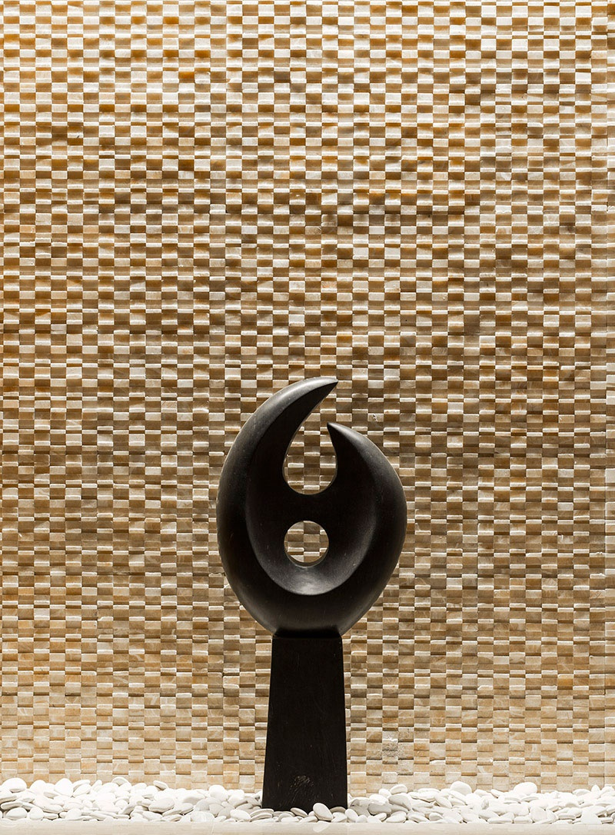
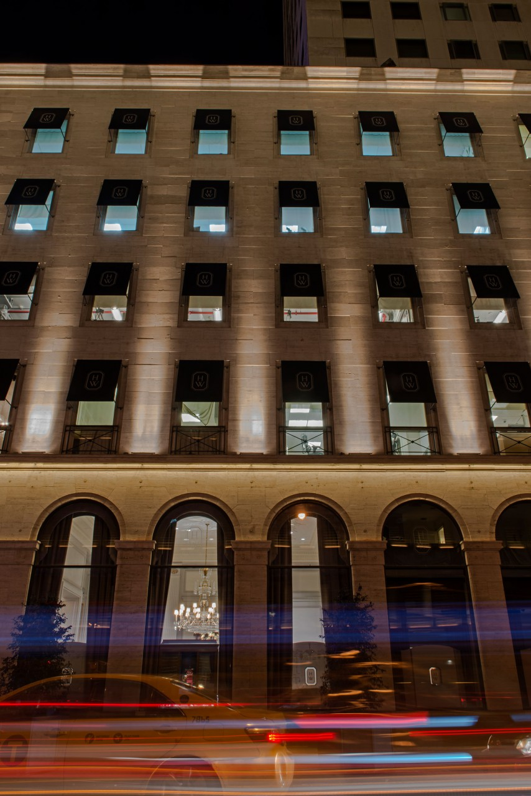
TRŌV | Applications – Wall Graze

Slide 21
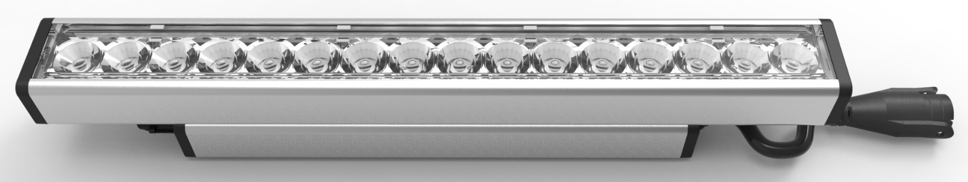
Graze | L50 Interior & Exterior Wall Grazer
Trov | L50 interior and exterior grazer is one of the smallest exterior grazers on the market. It is ideal for grazing textured walls, illuminating building facades, and back lighting.
Only 50mm(2”) tall by 42mm(1-5/8”) wide
Patented ELV dim to 0% output
Superior grazing optics using 2 collimating and 4 linear optics to create 8 different wall grazing treatments
  Power Options: 2W, 4W, 6W, 8W, and 10W per foot
CCT range 2200K, 2700K, 3000K, 3500K, 4000K, and 5000K
90 CRI available in 2700K-4000K
Mono colors in Red, Green, Blue, and Amber are also available
Multi-Volt 120V-277V input voltage
Aiming adjustment from 0°to 180°with patent pending flip-to-flat design
Interior & Exterior options available in the same form factor. The exterior version utilizes GORE® Vent technology and undergoes more testing than the interior.
Smallest
Grazer

Slide 22
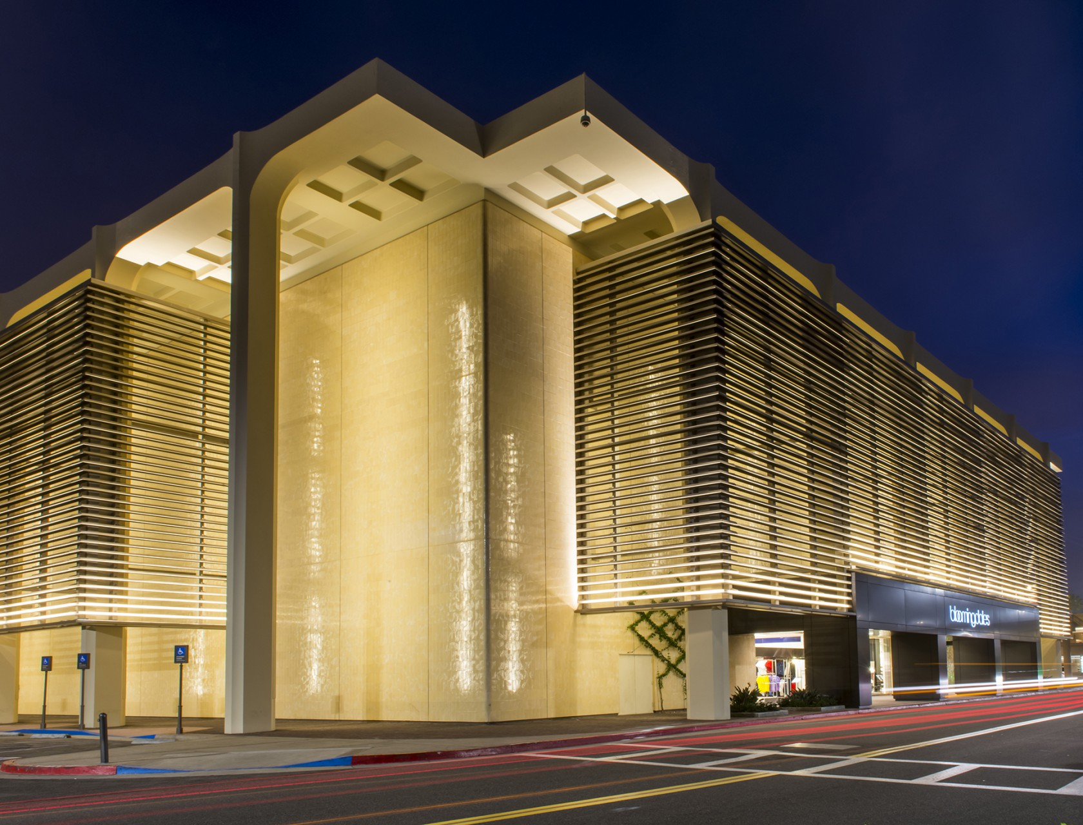
TRŌV | Applications – Wall Wash

Slide 23
Wash | L50 Interior & Exterior Wall Wash
Trov | L50 interior and exterior wall washer is one of the smallest exterior wall washers on the market. It is ideal for washing walls, illuminating building facades, and sign lighting.
Only 50mm(2”) tall by 42mm(1-5/8”) wide
Patented ELV dim to 0% output
Superior grazing optics using 2 collimating and 5 linear optics to create 12 different wall washing treatments
  Power Options: 2W, 4W, 6W, 8W, and 10W per foot
Wide CCT range 2200K, 2700K, 3000K, 3500K, 4000K, and 5000K
90 CRI available in 2700K-4000K
Mono colors in Red, Green, Blue, and Amber are also available
Multi-Volt 120V-277V input voltage
Aiming adjustment from 0°to 180°with patent pending flip-to-flat design
Interior & Exterior options available in the same form factor. The exterior version utilizes GORE® Vent technology and undergoes more testing than the interior.
Smallest
Wall Wash

Slide 24
TRŌV| Product Guide Chart
 | Model Number | Indoor | Outdoor | Length | Lumen Packages @ 4000K | Typical Watts/LF | Efficacy (lm/W) | Beam Options | CCT (22K, 25K, 27K, 30K, 35K, 40K, 50K) | Static Color (Red, Green, Blue, Amber) | High CRI 90+** | Multi-Volt | Control
TRŌV | L35 | • | N/A | 1', 4' | 160 | 2W | 80 | Cove 120° Beam | • (10W is not available in 2500K) | • | • | • | ELV; 0-10V*
 |  |  |  |  | 400 | 4W | 98
 |  |  |  |  | 570 | 6W | 95
 |  |  |  |  | 715 | 8W | 90
 |  |  |  |  | 980 | 10W | 98
 | L50 | • | • | 1',4' | 120 | 2W | 60 | Cove 120° Beam Line of Light Asymmetric Graze (9x29, 9x59, 15x15, 15x23, 15x35, 15x65) Wash (20x20, 20X28, 20x40, 20x70, 40x40, 40x48, 40x60, 40x90, 70x70, 39x9, 45x15, 70x70) | • (L50 is Not avalable in 2500K) | • | • | • | ELV; 0-10V*
 |  | • | • |  | 320 | 4W | 80
 |  | • | • |  | 500 | 6W | 85
 |  | • | • |  | 675 | 8W | 85
 |  | • | • |  | 850 | 10W | 85
 | * 0-10V Dimming is available using the EcoSpec® Linear Dimming Control Module
 | ** High CRI 90+may is not available in 2200K, 2500K, and 5000K.
 | Product Specs may vary. Visit www.ecosenselighting.com for up to date product specification information

Slide 25
Accessories

Slide 26
TRŌV | Accessories
Beautifully designed custom accessories allow for a wider range of product applications
All accessory to release day and date with the platform
Accessories Include:
  Louvers: Asymmetric, Symmetric & Honeycomb
  Snap on Frosted and Clear Lenses
  Masking Plates
  Mounting Track
  Mounting Clips
  Wall Mount Arm System
  Fine Adjustment Bracket
  Angle Lock Clip
  L-Bracket
  Landscape Mounting Stake

Slide 27
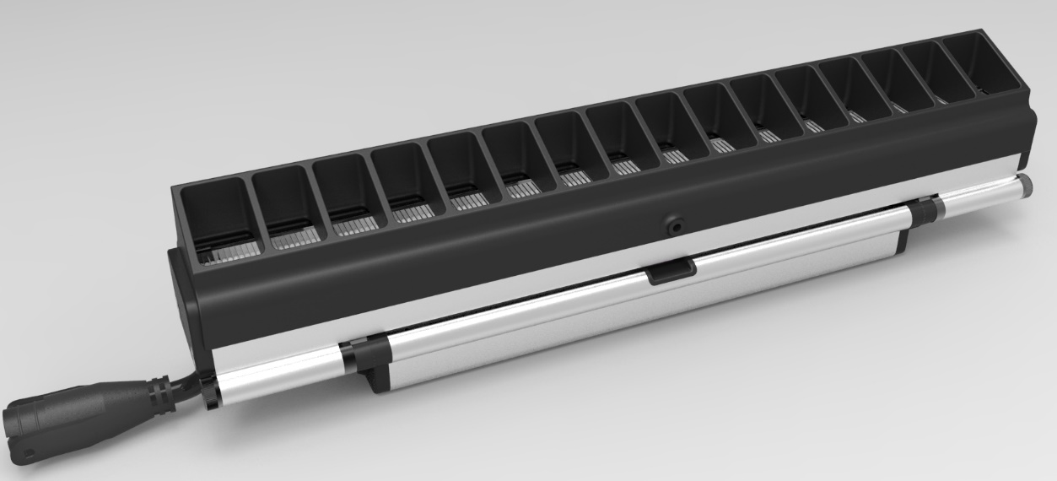
TRŌV | Louvers
Trōv louvers provide cutoff of glare for wall grazing applications where the fixtures are visible without any significant light loss.
Asymmetric and Symmetric louvers for L50
1’ lengths only with light leak gasket one both ends
Will be made from High impact, UV stabilized, Non-Corrosive, Polycarbonate
Textured PC will provide a nice finish that will never fade
Injection Molded PC part will greatly reduce cost

Slide 28
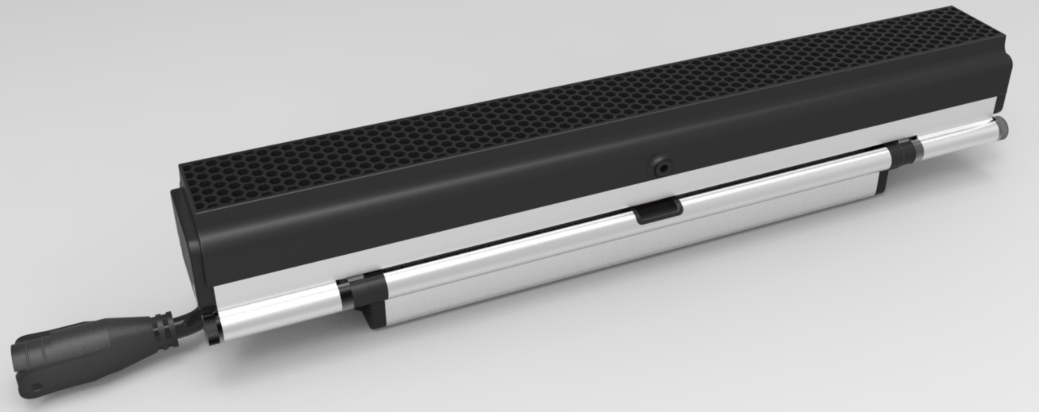
TRŌV | Honeycomb Louver
Trōv Honeycomb Louvers provide excellent cutoff of glare for wall grazing applications where the fixtures are visible.
Snap on honeycomb louver only adds 3/8” to the height of the L50
1’ lengths only with light leak gasket one both ends
Will be made from High impact, UV stabilized, Non-Corrosive, Polycarbonate
Textured PC will provide a nice finish that will never fade
Injection Molded PC part will greatly reduce cost

Slide 29
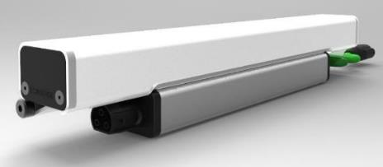
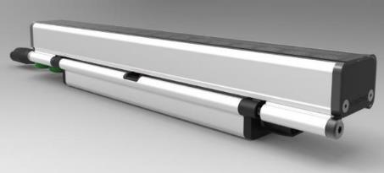
TRŌV | Snap On Frosted And Clear Lens
Trōv Snap on Frosted Lenses are used to diffuse light for applications where the fixture is visible.
Trōv Snap on Clear Lenses are used to hold Rosco/Lee coloring films
(Film supplied and installed by others)
1’ and 4’ lenses snap on to fixtures without any tools. They can be added after the fixtures are already installed.

Slide 30
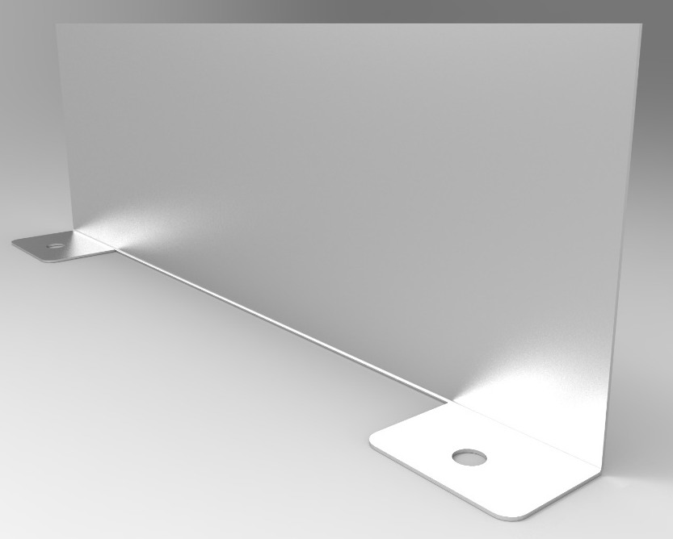
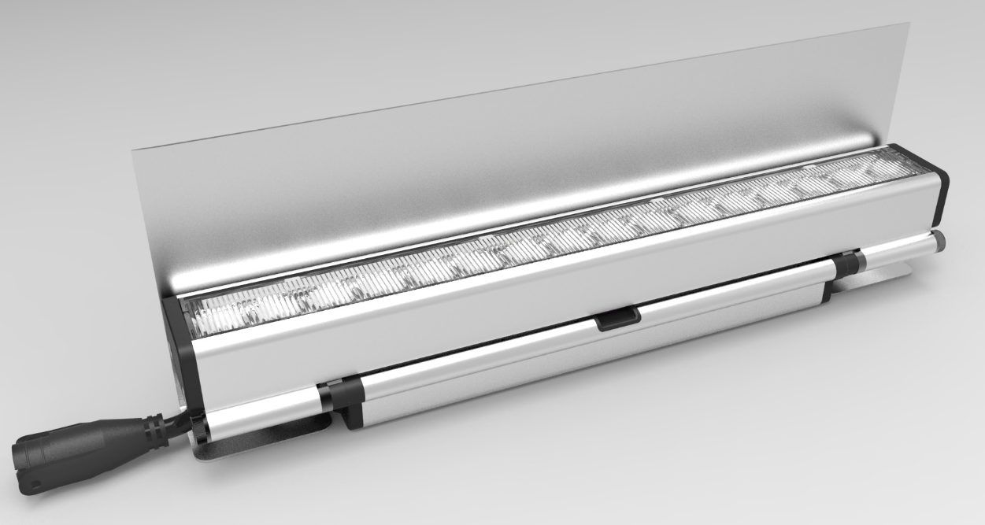
TRŌV | Masking Plates
Trōv Masking plates are used when no structure exist to hide the fixture.
Masking plates can be installed before the fixtures and can be painted in the field.
3” Masking plate is standard
Custom Heights can be made/ordered
Finish: Brushed clear anodized aluminum
Lengths: 1’ and 4’ Available

Slide 31
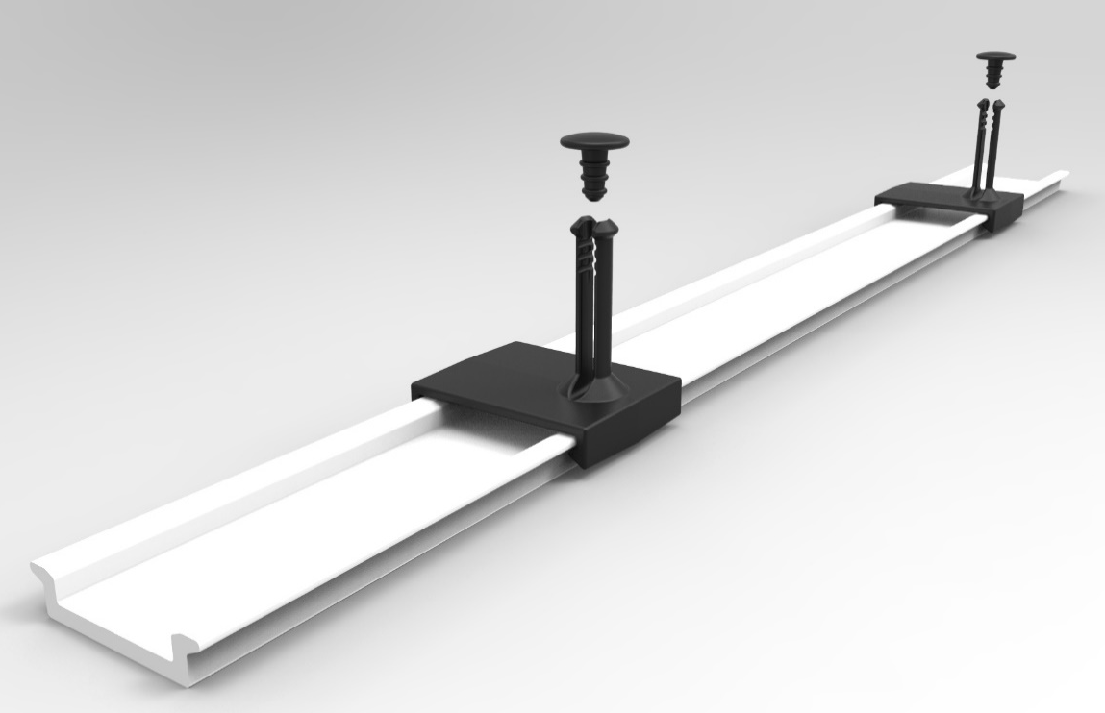
TRŌV | Mounting Track & Clips
Track and clips are used when the mounting needs to be done before the fixtures. The track can be screwed into place before the space in finished. Painting and plastering can be done with the track installed. The Clips are then snapped into the fixture then snapped on the track making final installation easier.
Lengths: 1’ and 4’ field cuttable mounting track

Slide 32
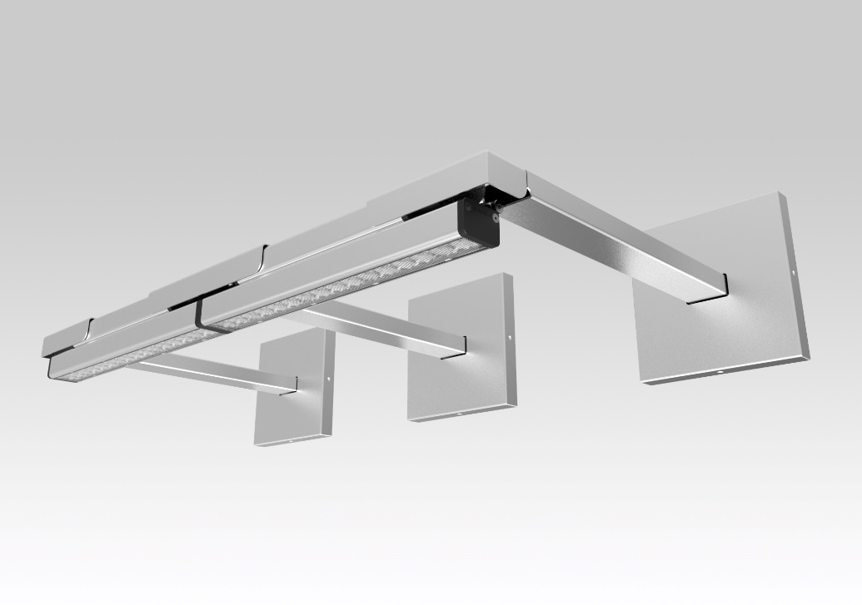
TRŌV | Wall Mount Arm System
Trōv mounting arms are used when there is no structure to mount the fixture away from the wall.
Available is 6”, 12”, 18” & 24” lengths
Finish:
  End and Joining Plate: Brushed clear anodized aluminum
  Arms and Canopy: Painted Silver
How it works:
  The mounting plate directly mounts to all common junction boxes
  The mounting arm will then hook onto the plate so the leader cable can be easily wired without having to hold the arm up
  Canopy installs without any visible hardware
  Leader cable will run through the arm to be out of view
  Joining connector will be covered by joining plate
  End and joining plates will be finished to match fixture. Arms and canopy will be painted silver

Slide 33
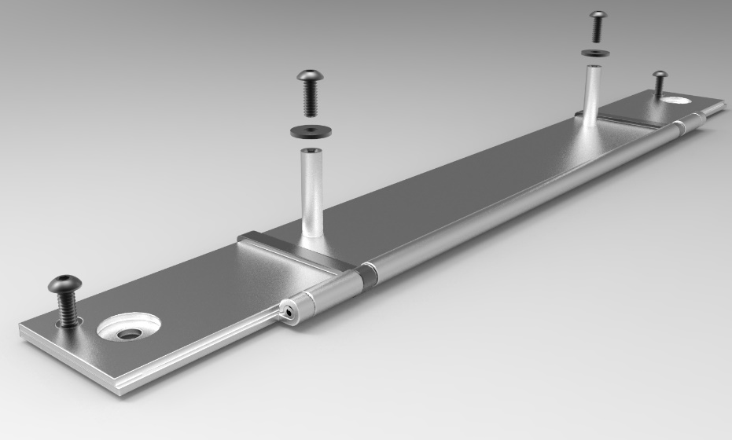
TRŌV | Fine Adjustment Bracket
Trōv Fine Adjustment Brackets are ideal for applications that require angle adjustments smaller than 15º
Standard fixture adjustment angle: 15º
Fine adjustable bracket can be set to any angle from 1º to 15º

Slide 34
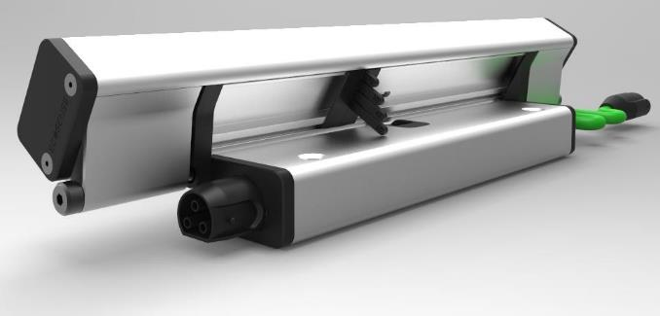
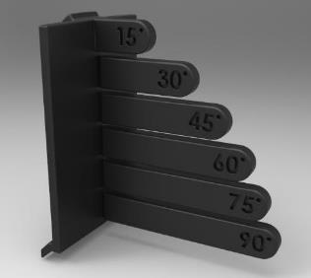
TRŌV | Angle Lock Clip
Trōv Angle Locks are used to prevent accidental fixture adjustment
Easy to install angle locks works without any tools
Simply break off the tabs to get to the desired angle
Snap on underneath the led module

Slide 35
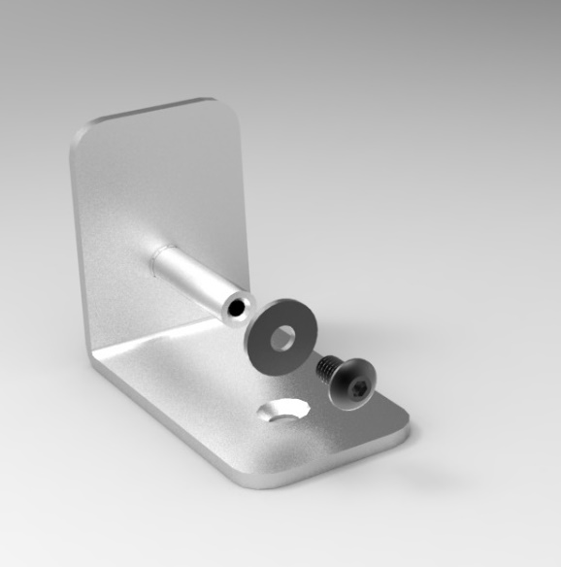
TRŌV | L-Bracket
Trōv L-Brackets are used to:
  Mount the fixture on it’s side which is ideal for low profile coves while aiming the fixture
  Mount the fixture directly to the wall which is ideal when no other structure exist.

Slide 36
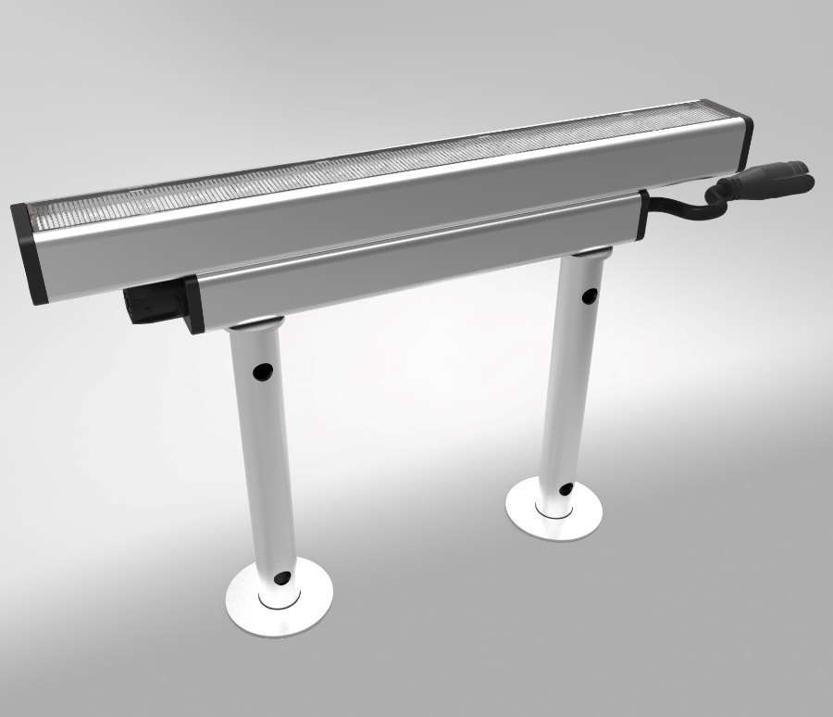
TRŌV | Landscape Mounting Stake
Trōv Landscape Stakes are ideal for mounting the fixture in grass or dirt. They are typically used to light signage in landscapes.
Mounts directly into the ground
Fixture mounts directly to the top of the stake
Sold in sets of 2, so order one set per fixture.
Comes in 3 length measured from the ground to the top of the stake:
      6”
      12”
      18”
Cable pass through prevents the need for zip-ties

